Slide 1
Water probe and Rainfall sensor Update
Keith Matthews

Slide 2
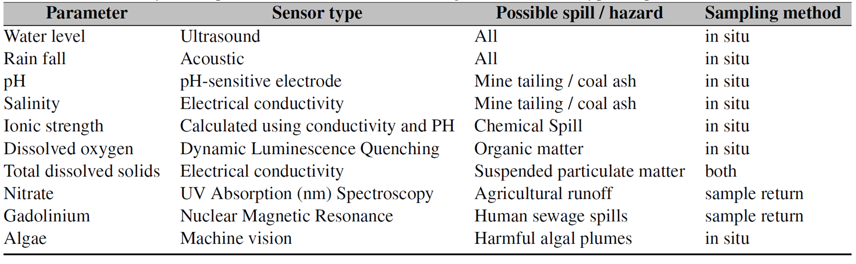
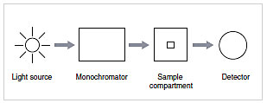
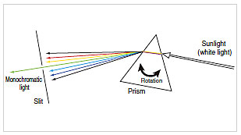
Measuring Nitrates
Chemical Test: Ring Test (iron(II) sulfate and sulfuric acid)
In Situ with UV absorption?
Servo: to move the diffuser
Monochromator
Source (Sun?)
Detector (photosensor)
Measurement range
Detect other materials in the water?
Monochromator
Angle determines the wavelength

Slide 3
Nitrates
Determination of Nitrate in Water Containing Dissolved Organic Carbon by Ultraviolet Spectroscopy
200-205 nm & 300 nm
2 wavelengths avoid organic intereference

Slide 4
Dissolved oxygen
Rapid and precise determination of dissolved oxygen by spectrophotometry: Evaluation of interference from color and turbidity
430nm
Low organic interference

Slide 5
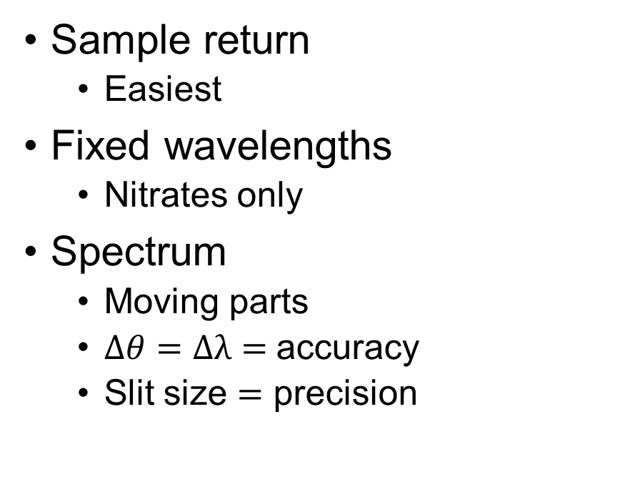
Uv absorption
Sample return
Easiest
Fixed wavelengths
Nitrates only
Spectrum
Moving parts
$∆θ=∆λ=$accuracy
Slit size $=$ precision

Slide 6
Battery
Samsung cylinder batteries?
Stackable
Flexible design
One charger for all
LiPo
Charging?
Replacing

